Slide 1


REVOLUCIONANDO TTO DEL PTCL-RR: Simposio sobre el horizonte terapéutico de la Darinaparsina

Slide 2

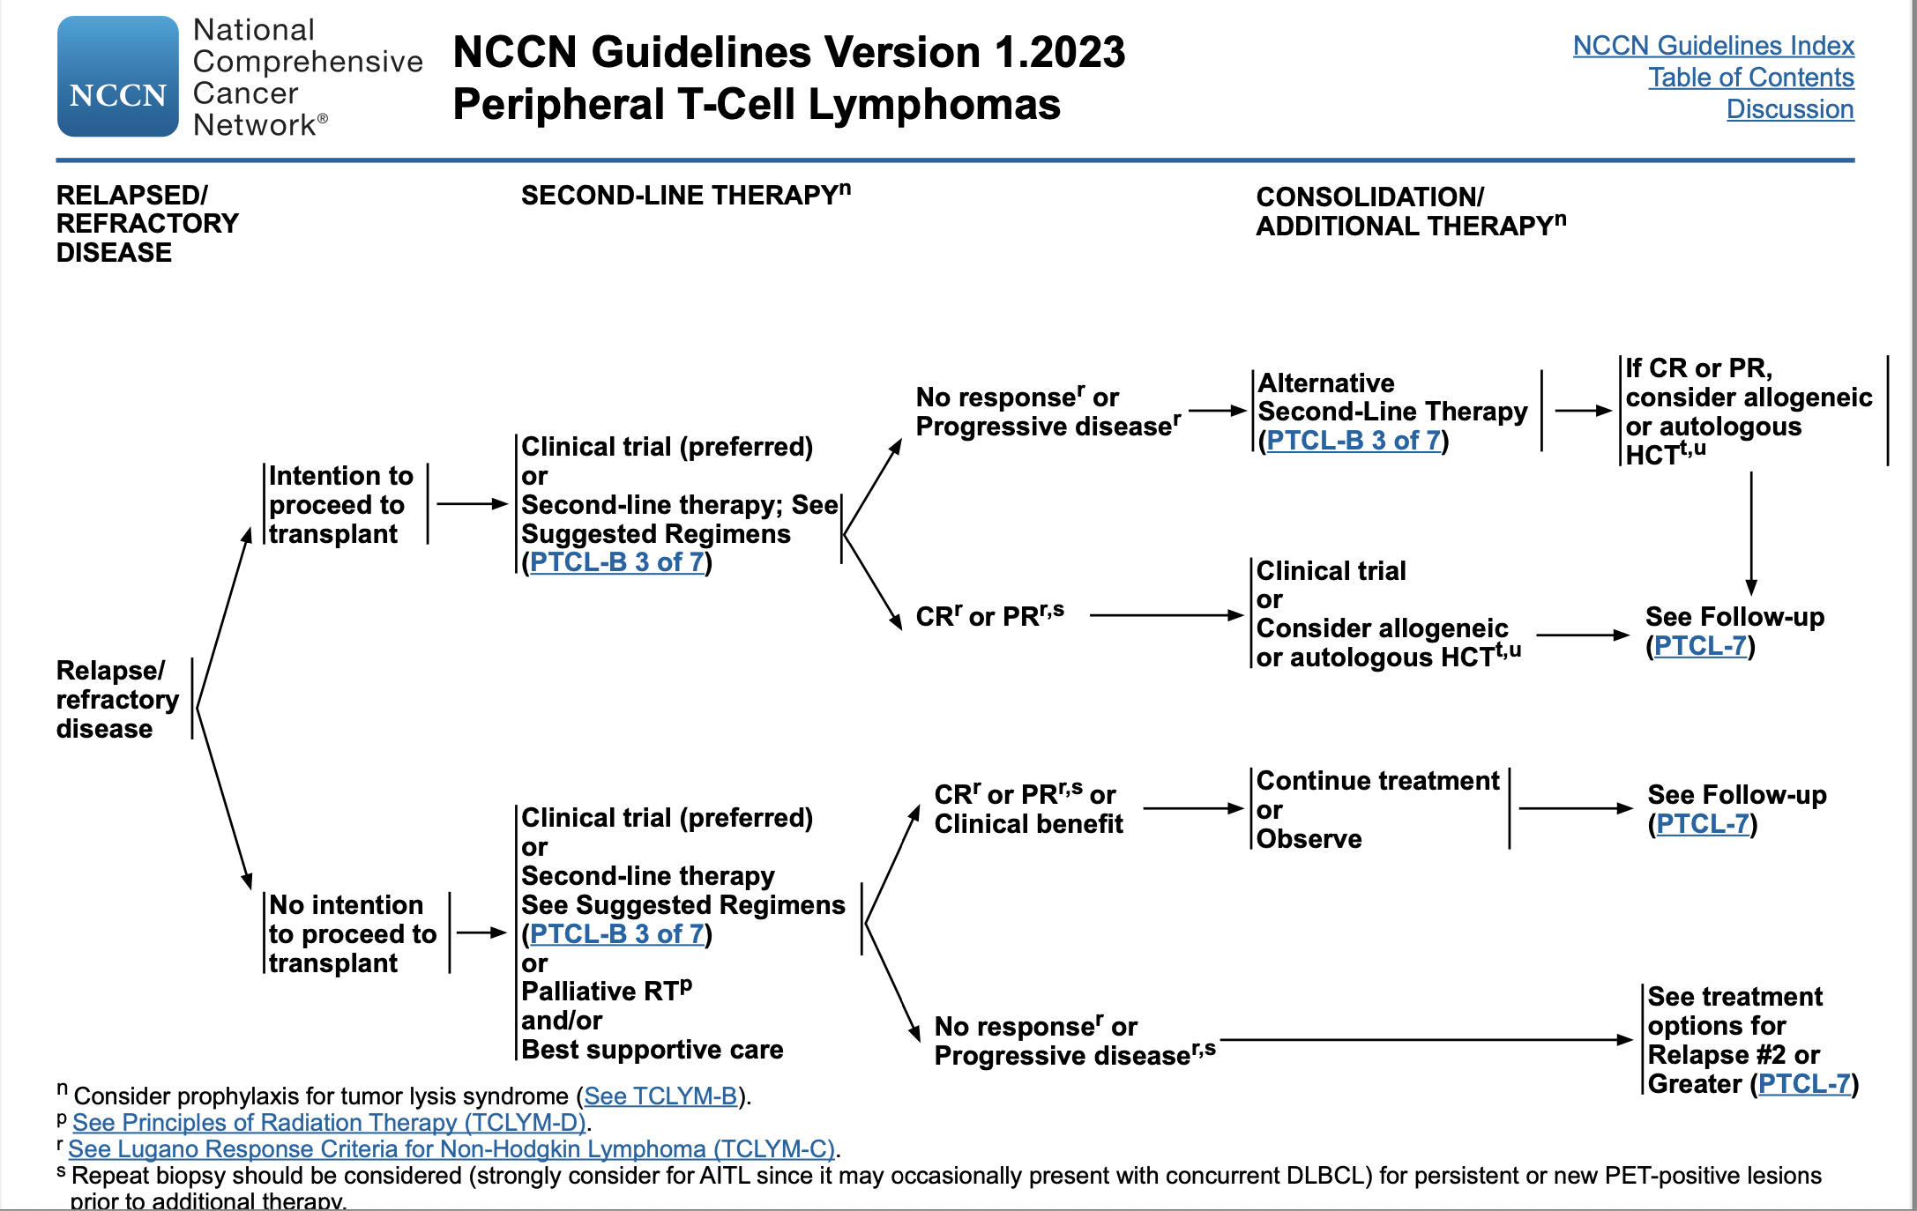

Slide 3
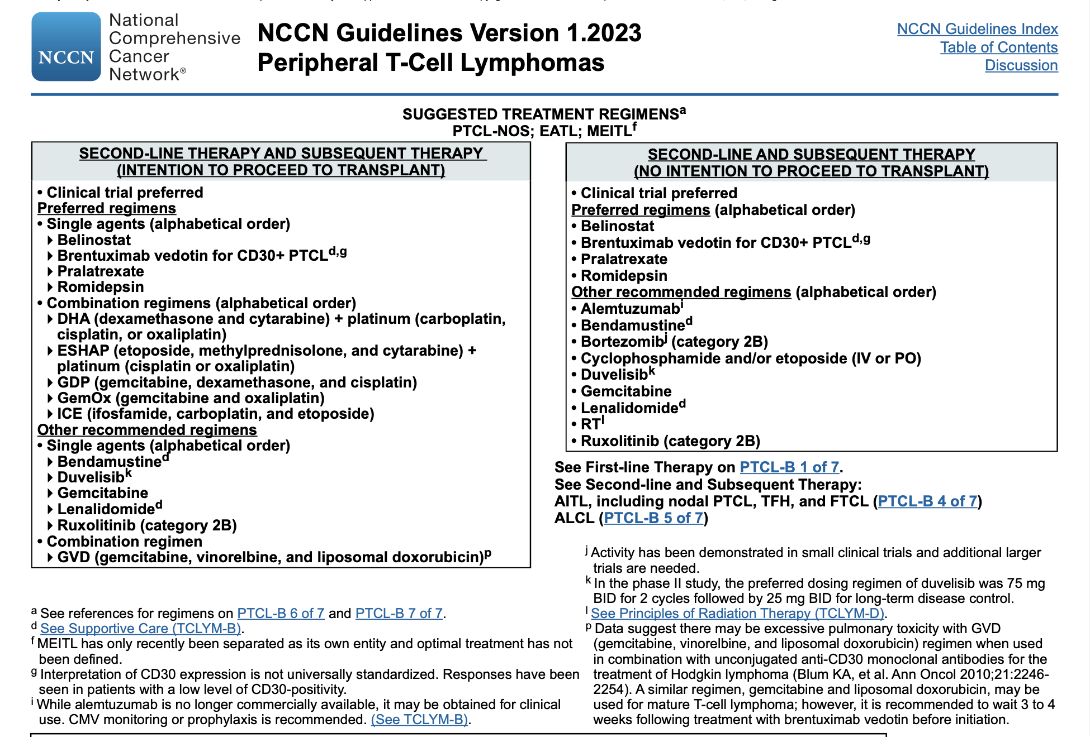

Slide 4
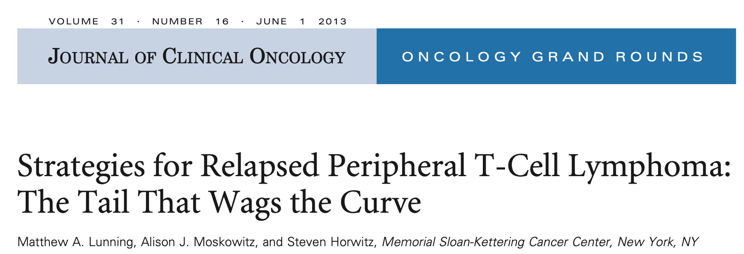
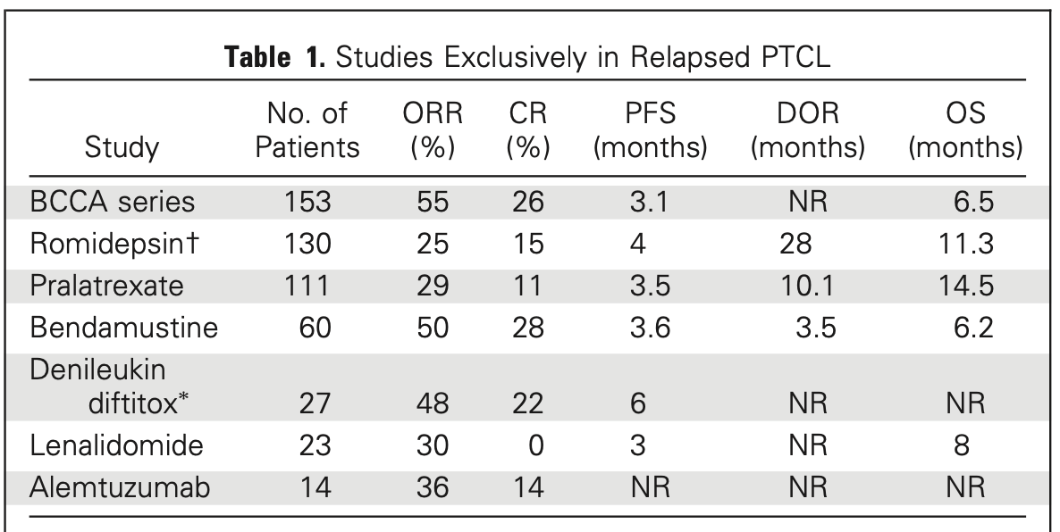

Slide 5


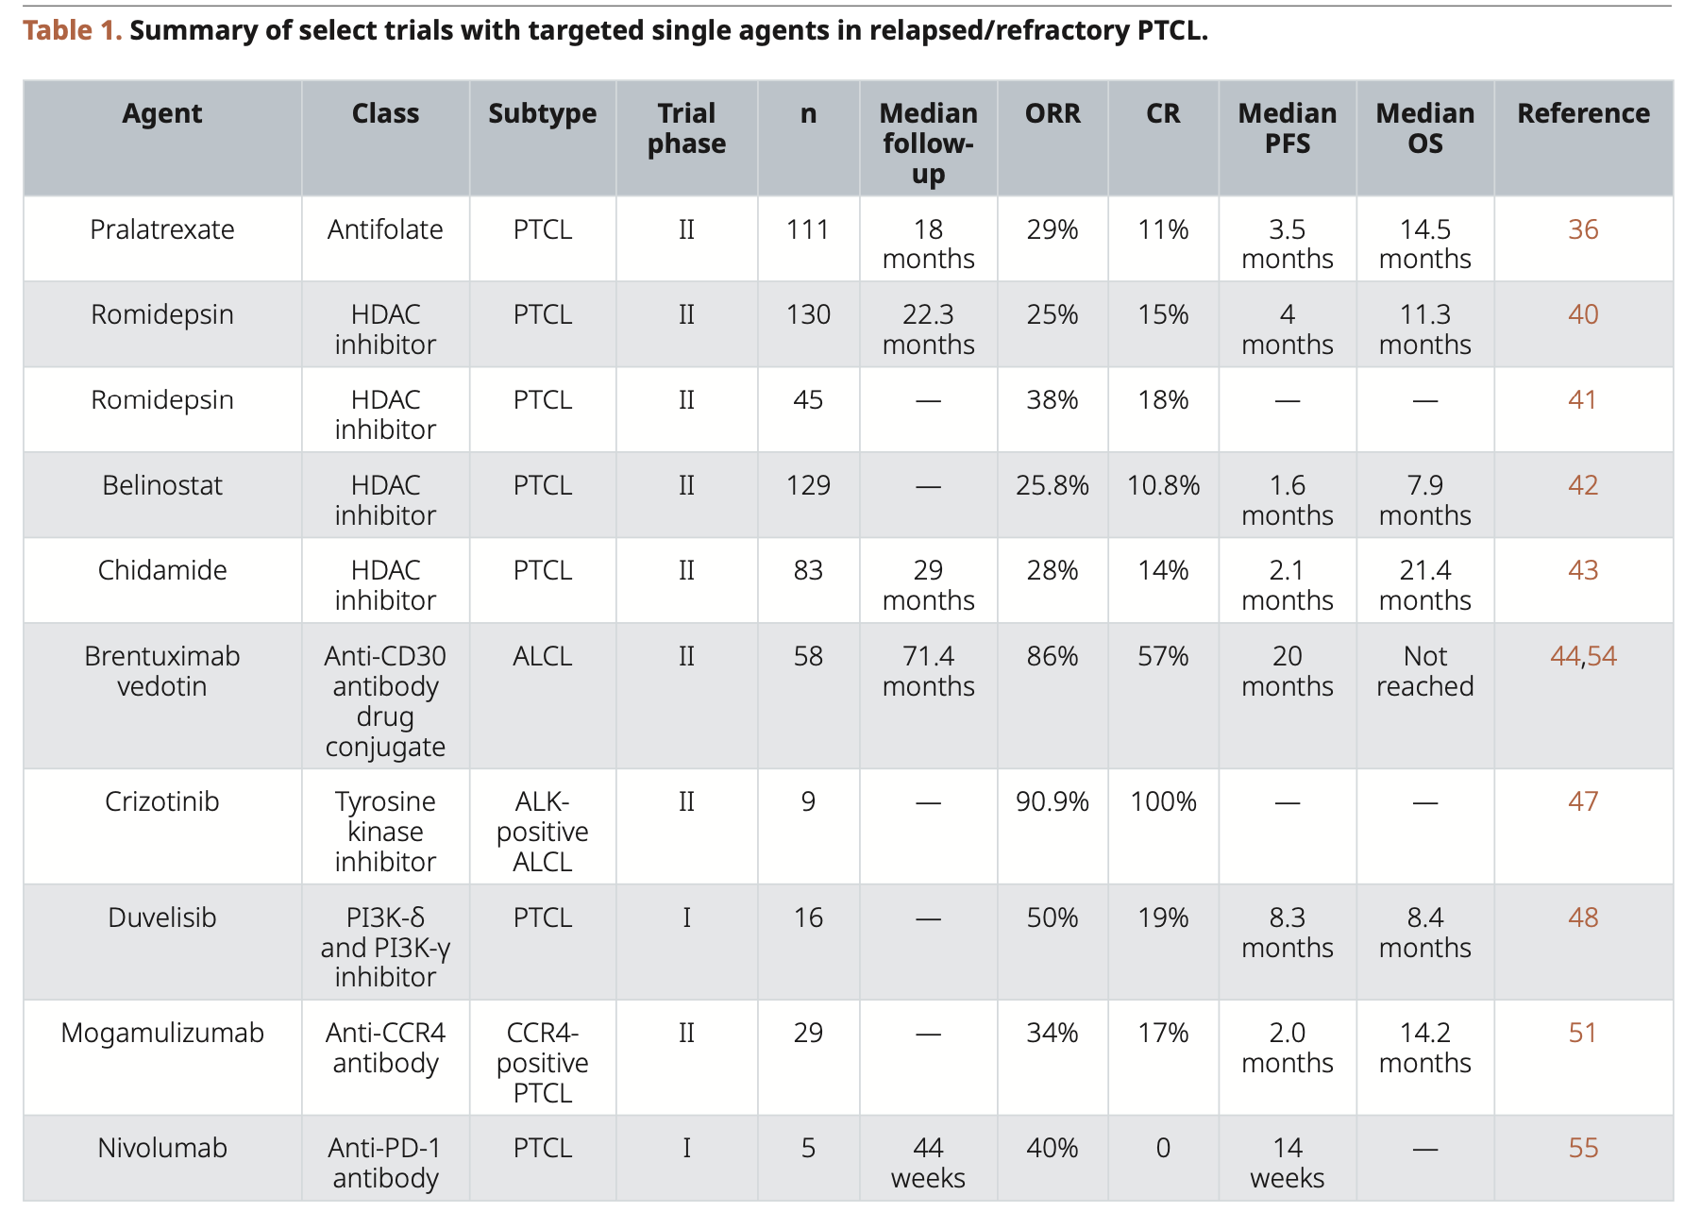
F1000Research 2020, 9(Faculty Rev):1091 Last updated: 31 MAR 2022

Slide 6
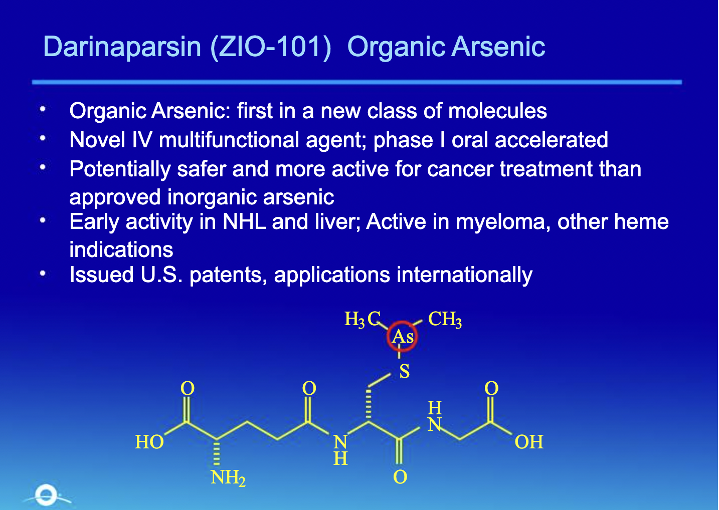

Slide 7
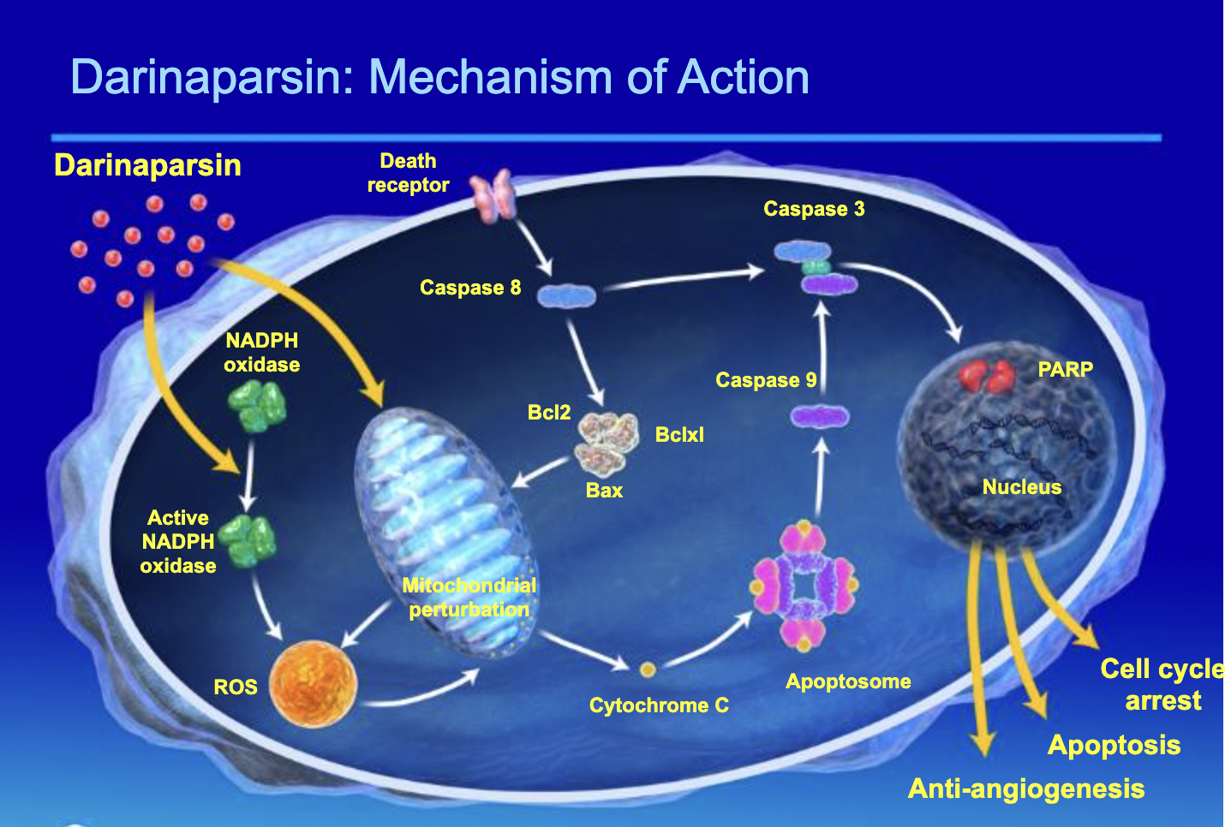

Slide 8

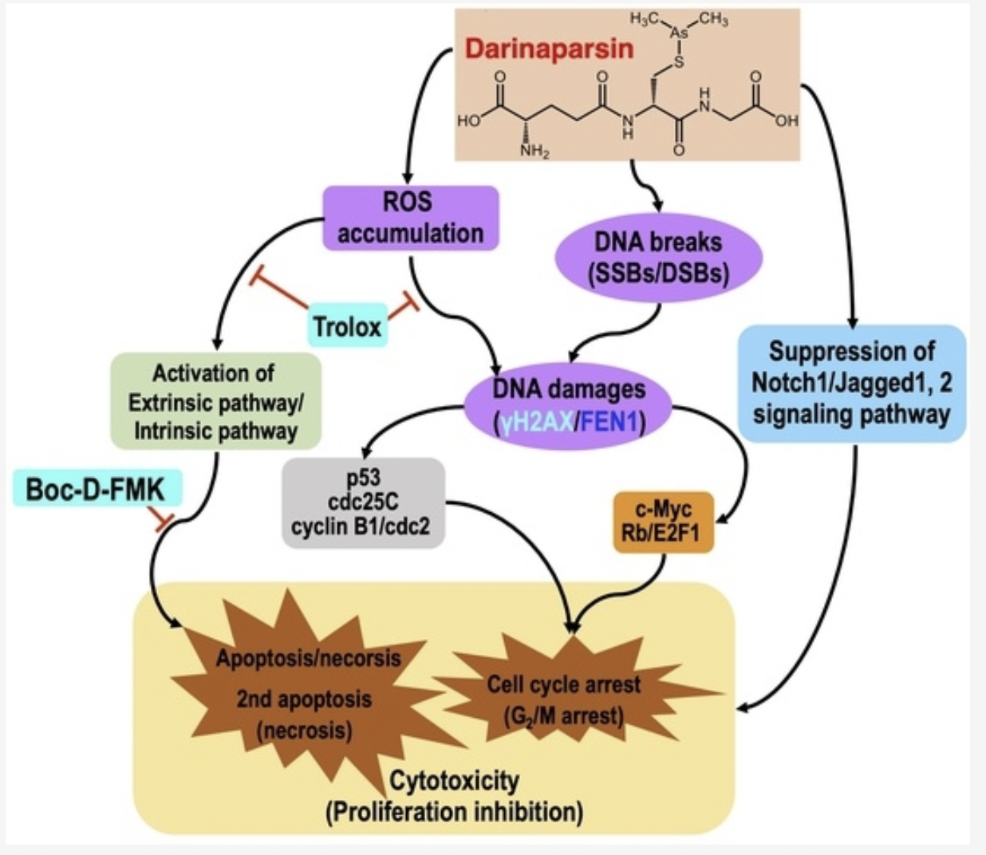

Slide 9


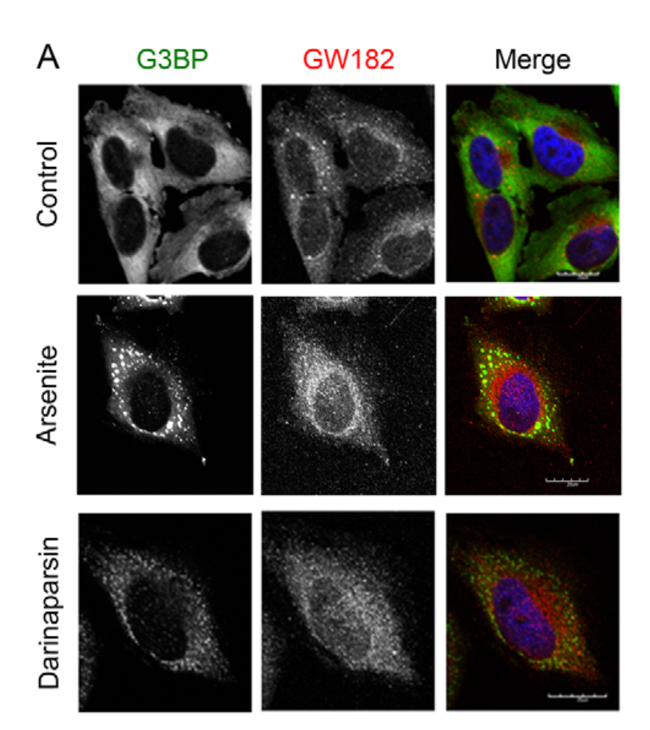
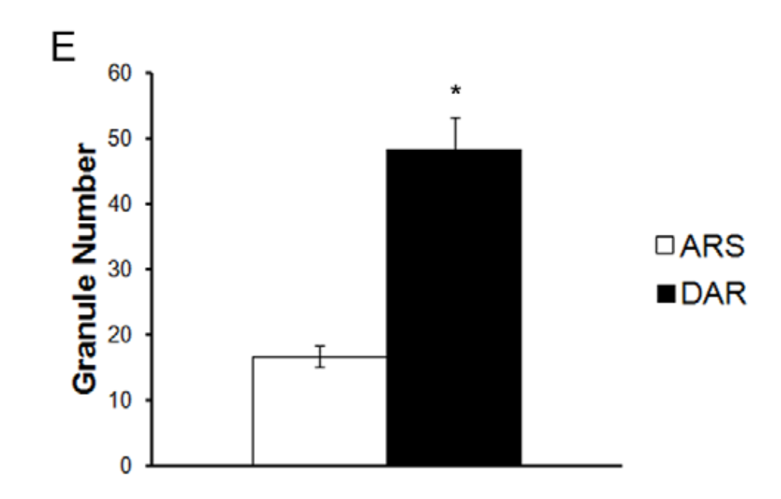
November 2011 | Volume 6 | Issue 11 | e27699

Slide 10
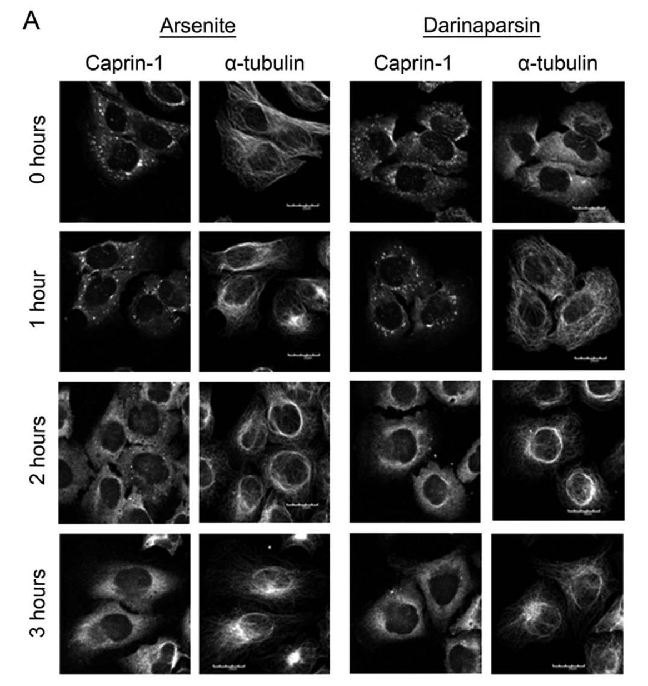
November 2011 | Volume 6 | Issue 11 | e27699

Slide 11
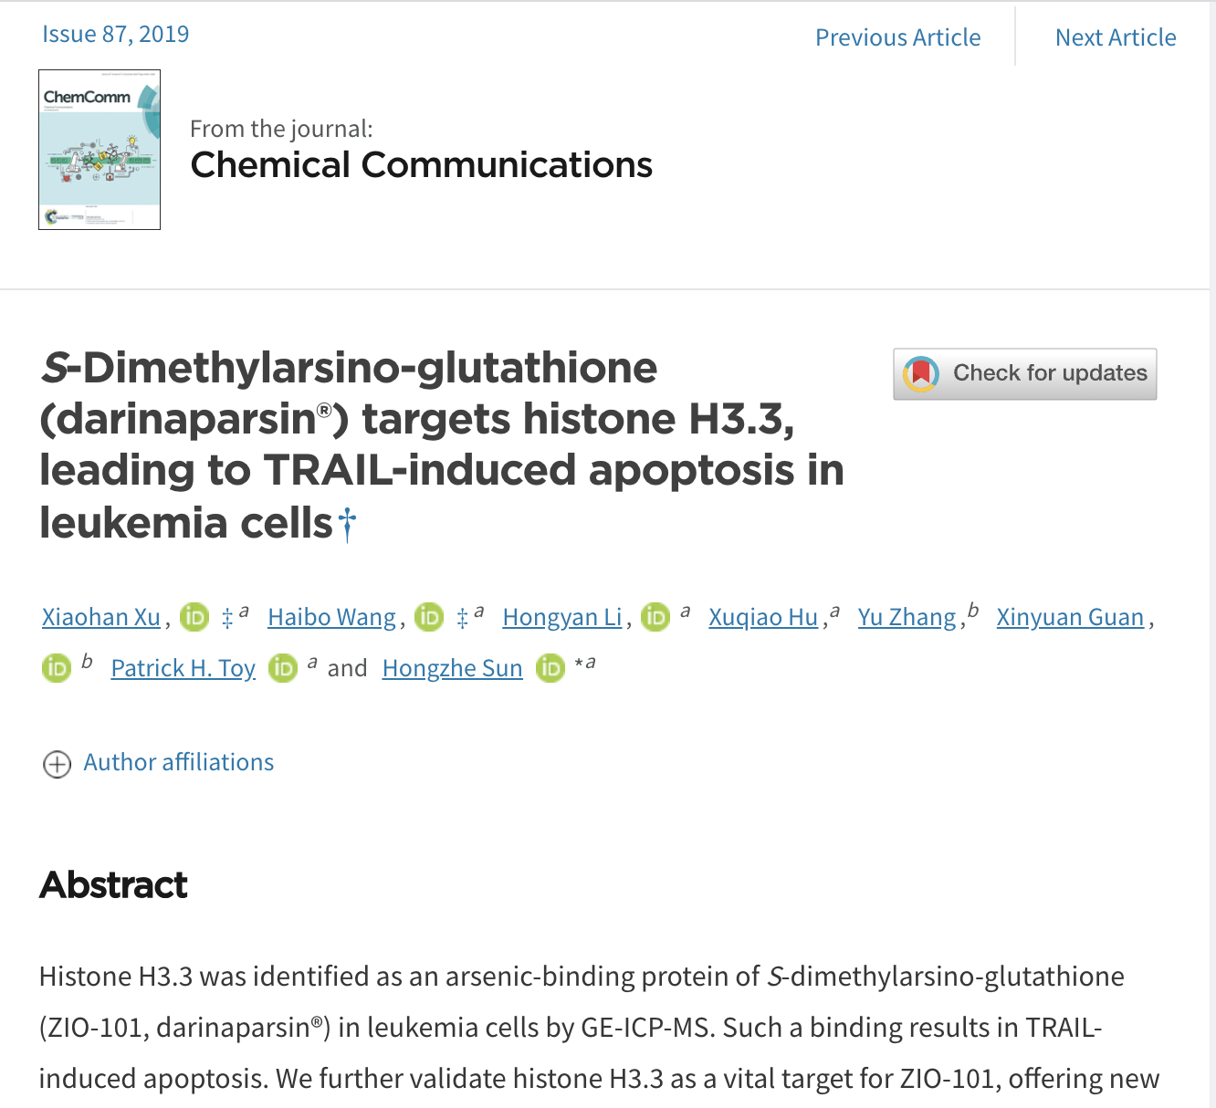
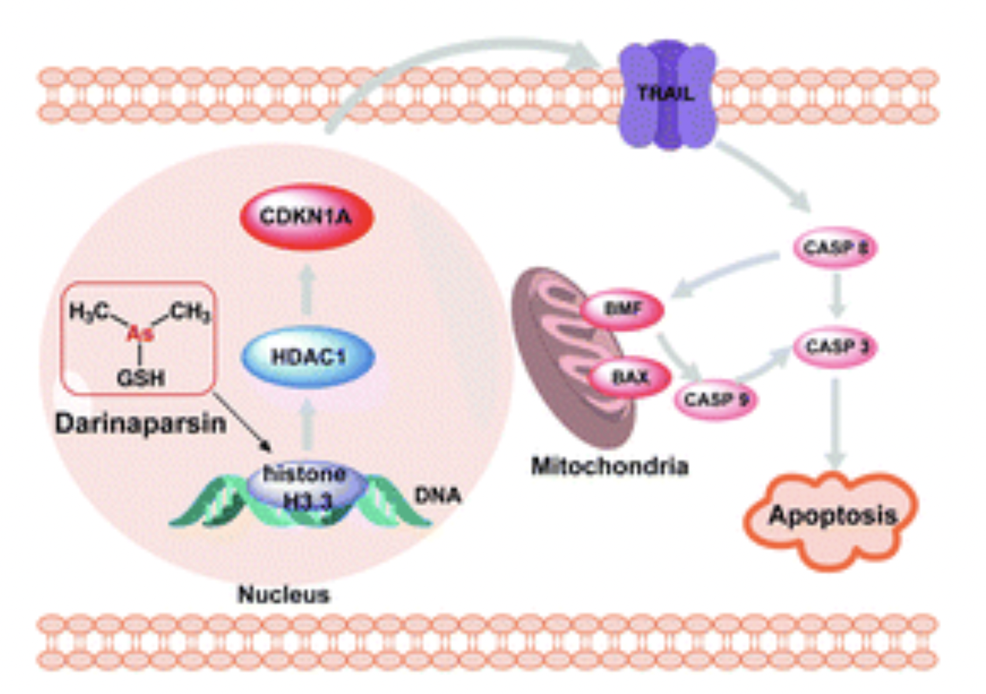

Slide 12
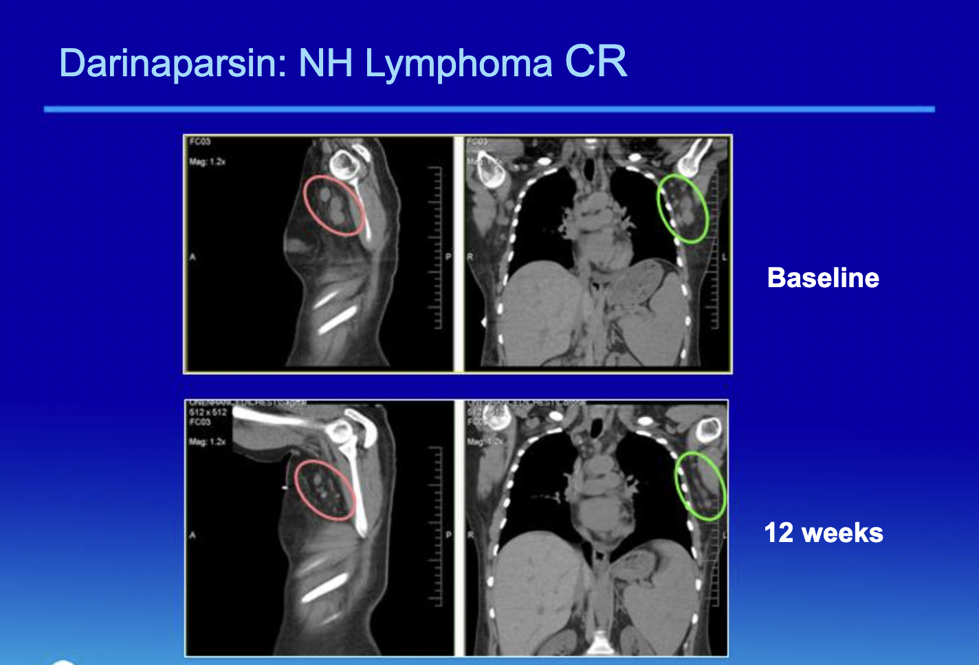

Slide 13
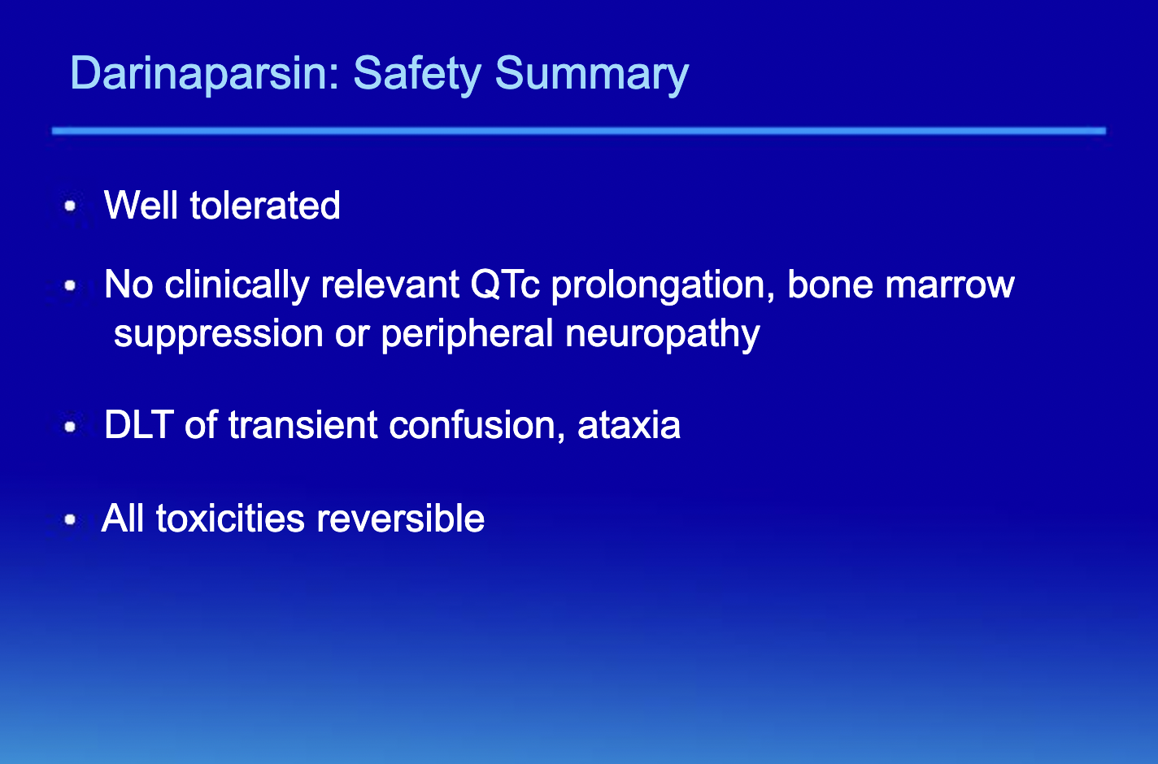

Slide 14
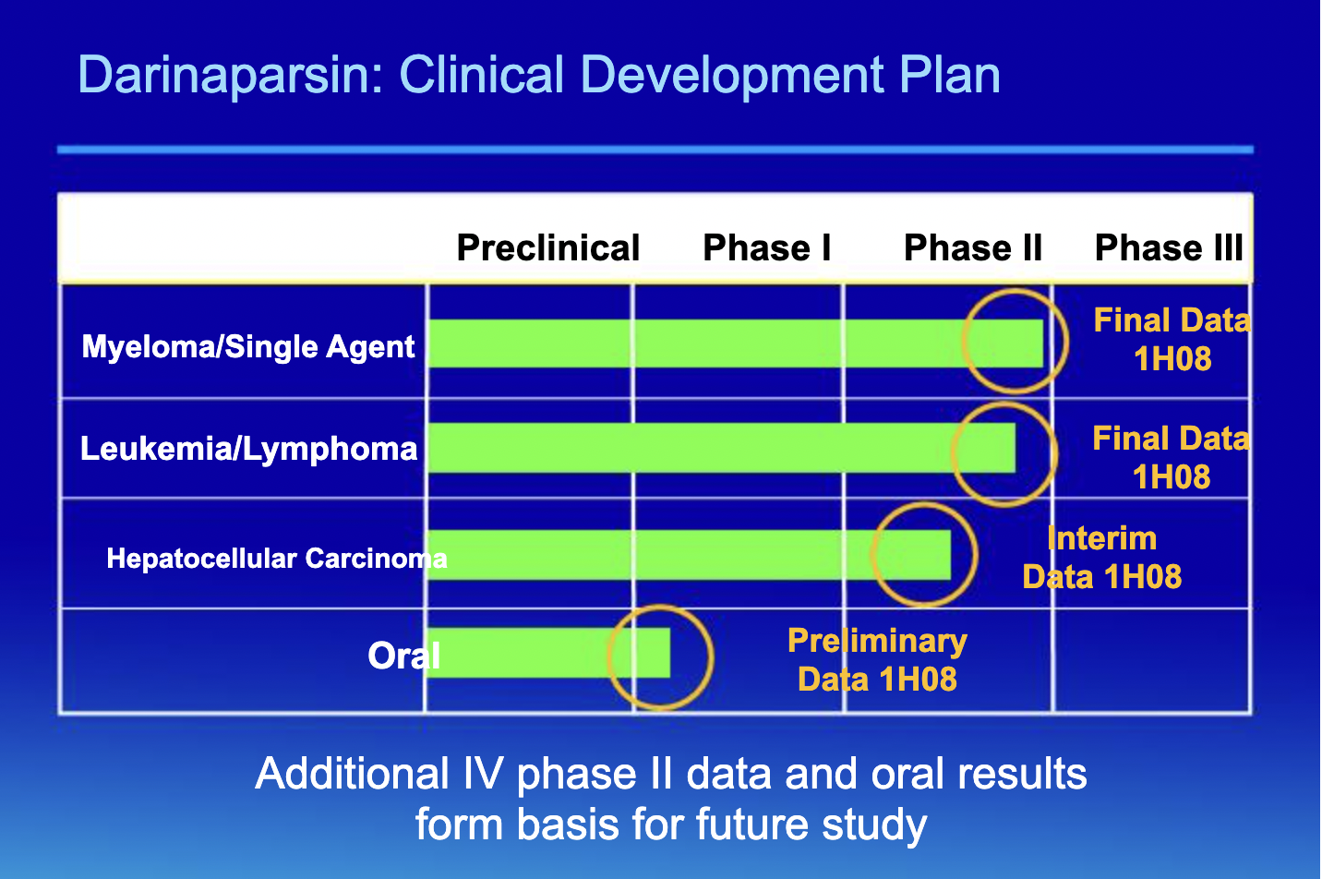

Slide 15


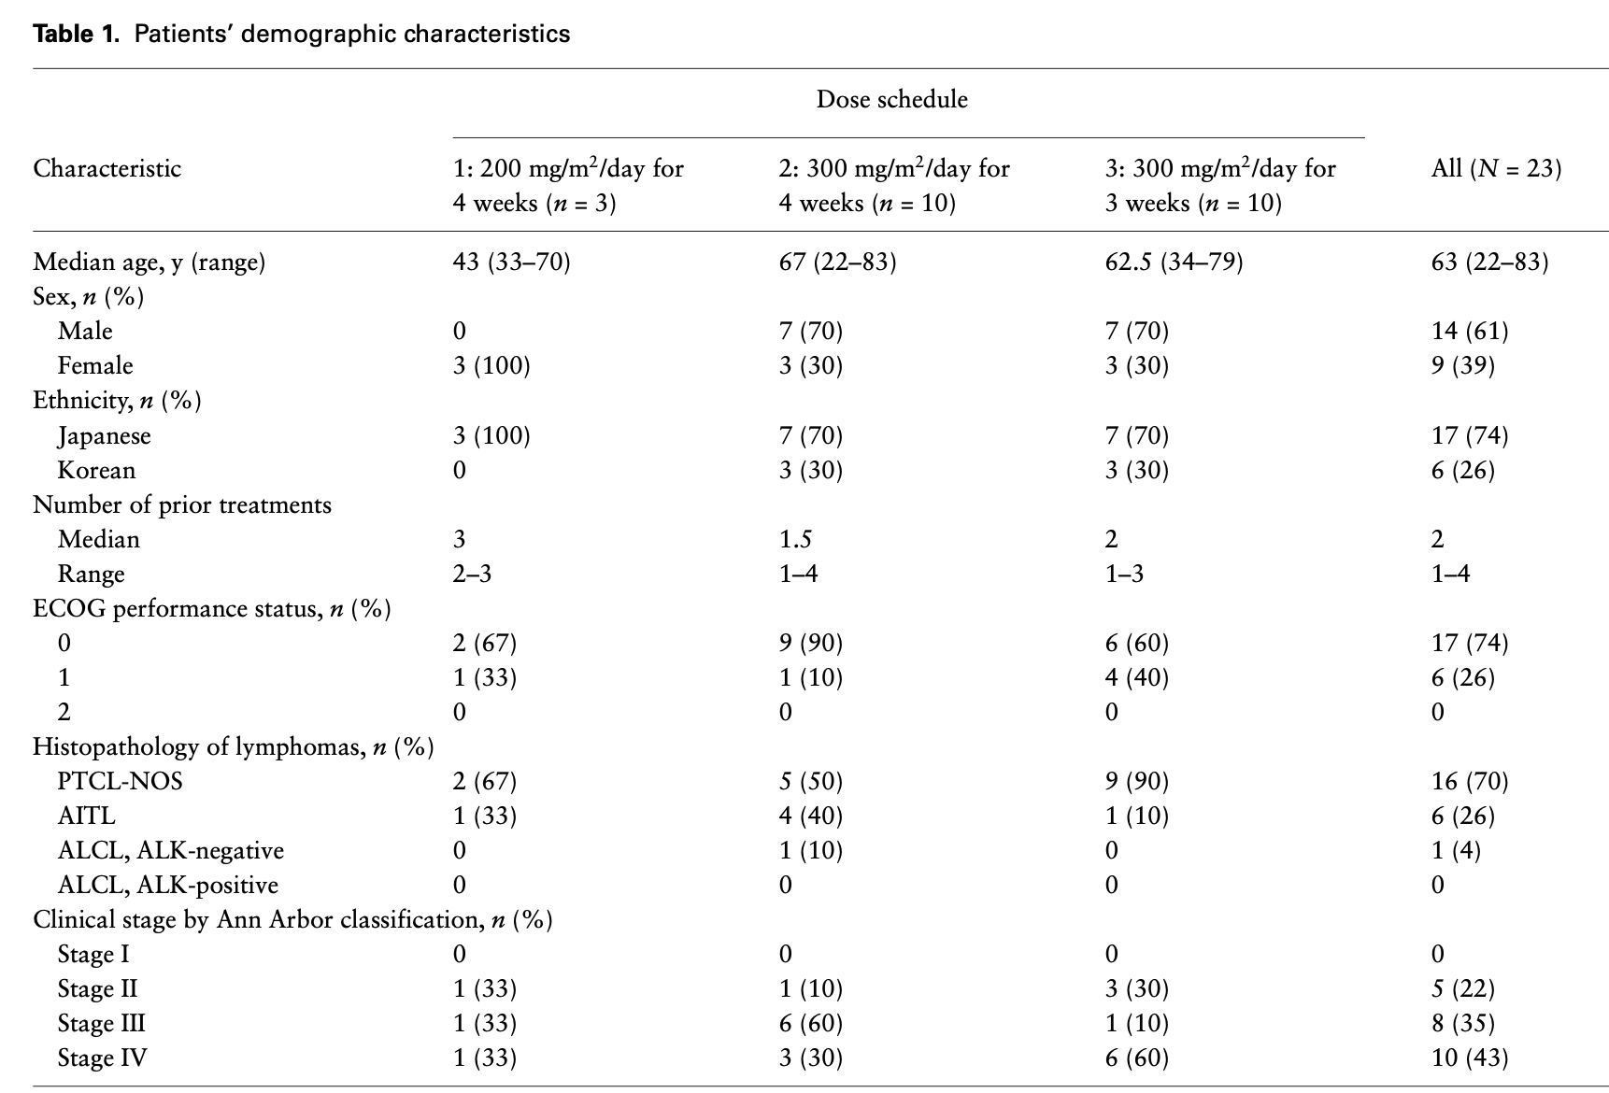

Slide 16
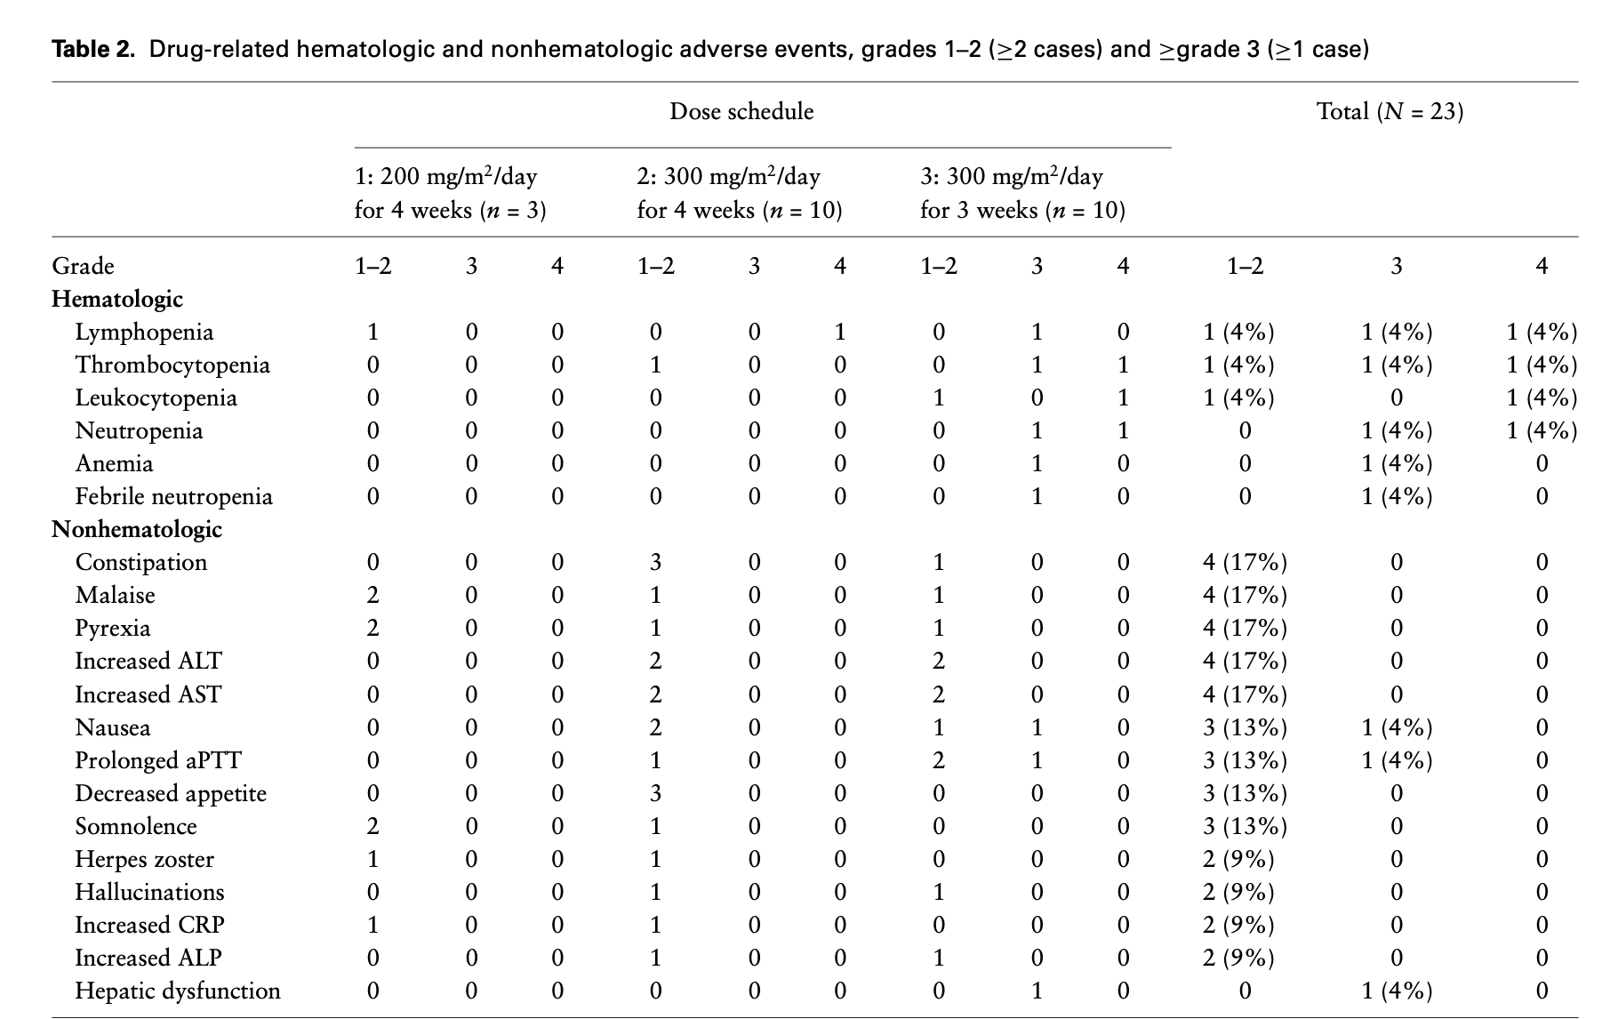

Slide 17
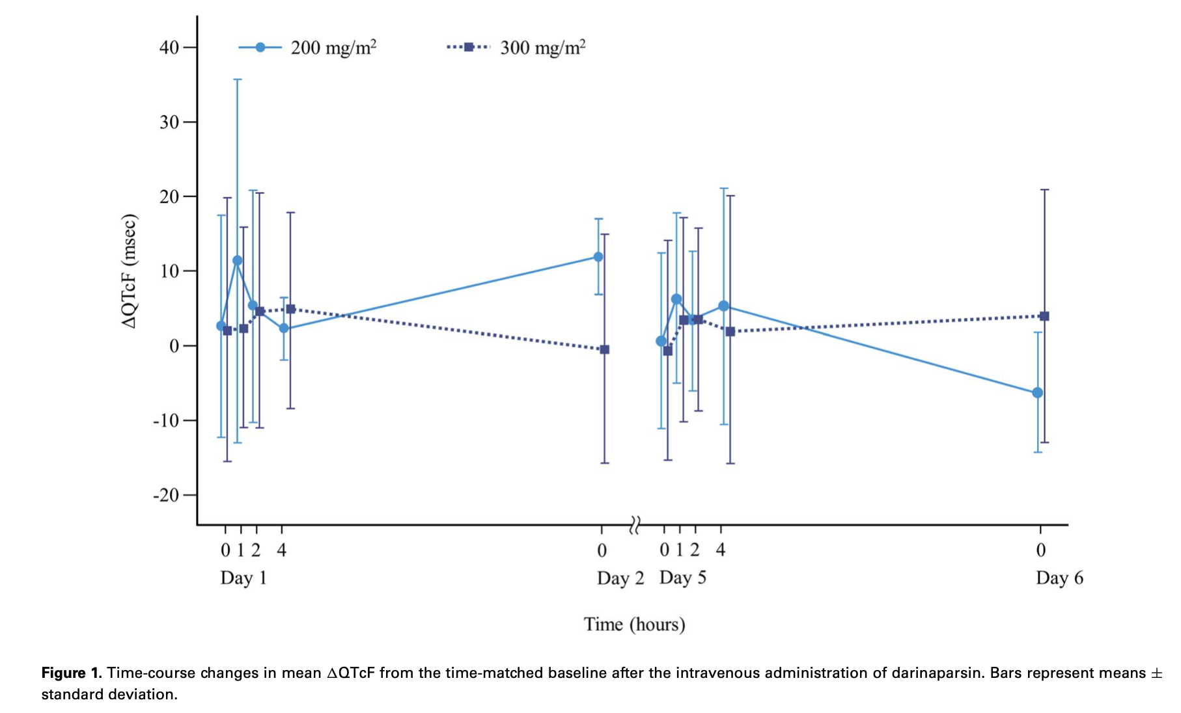

Slide 18
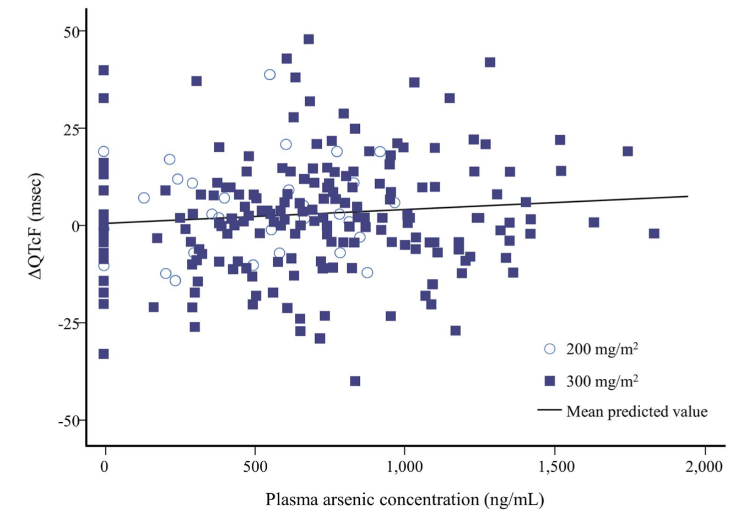

Slide 19
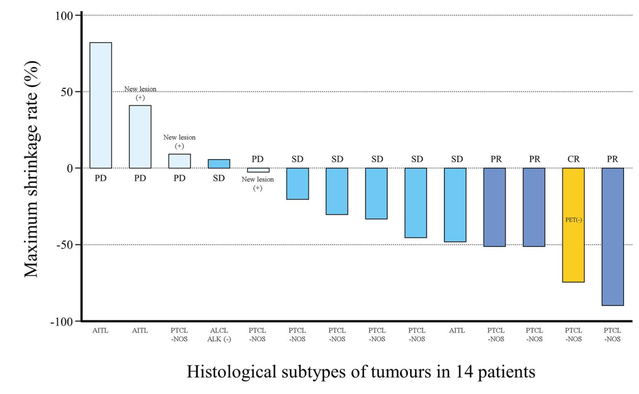

Slide 20

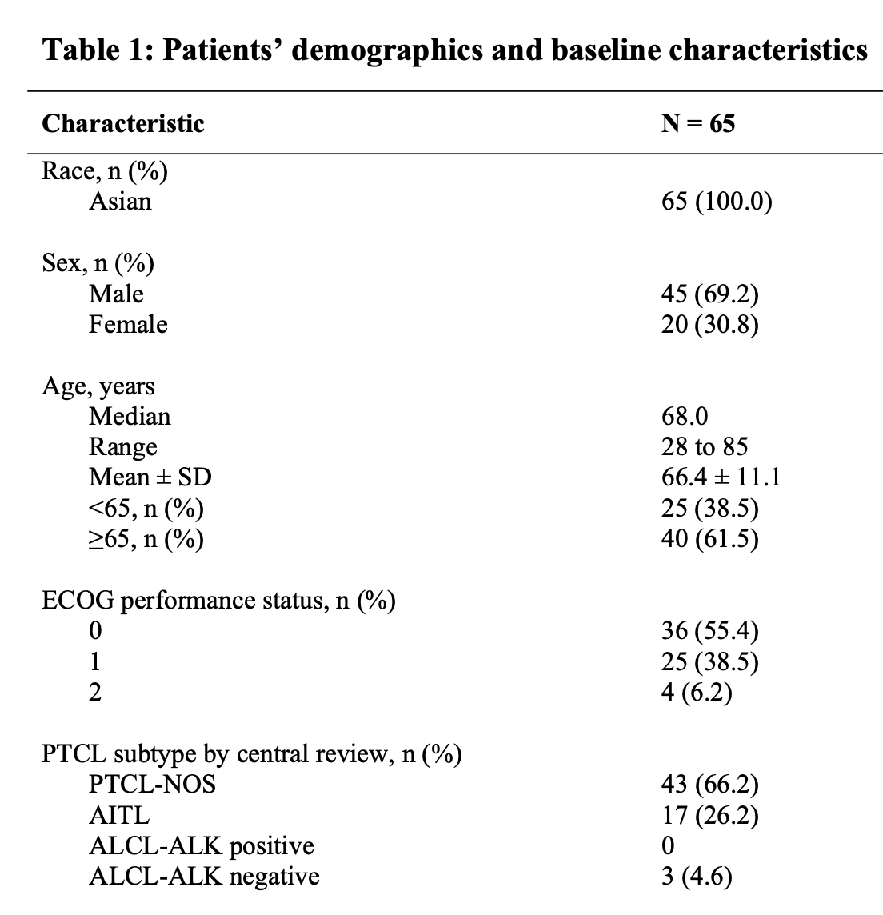
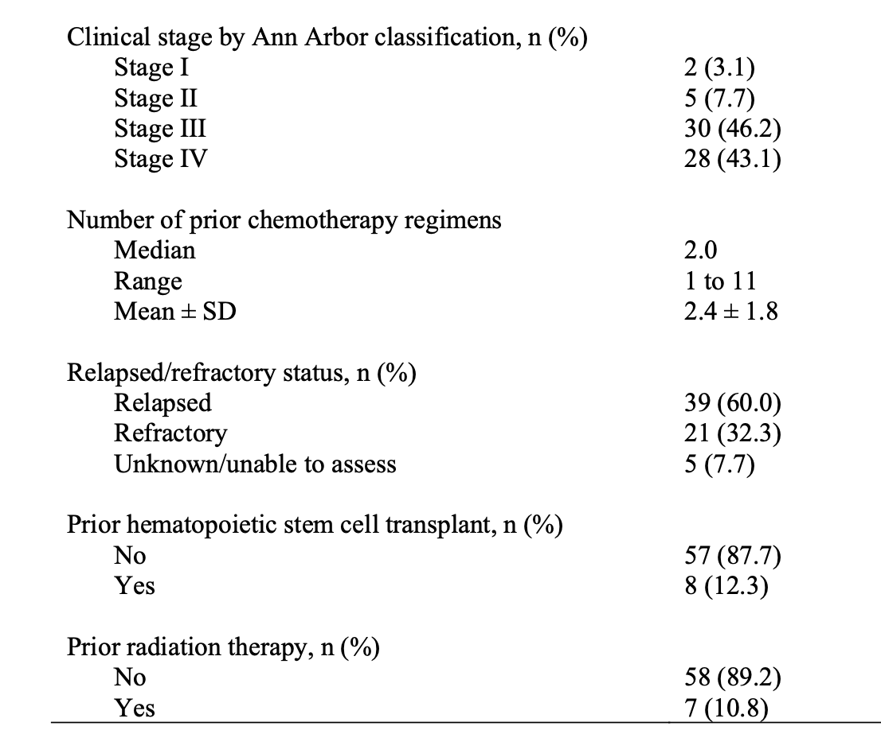
ClinicalTrials.gov: NCT02653976

Slide 21
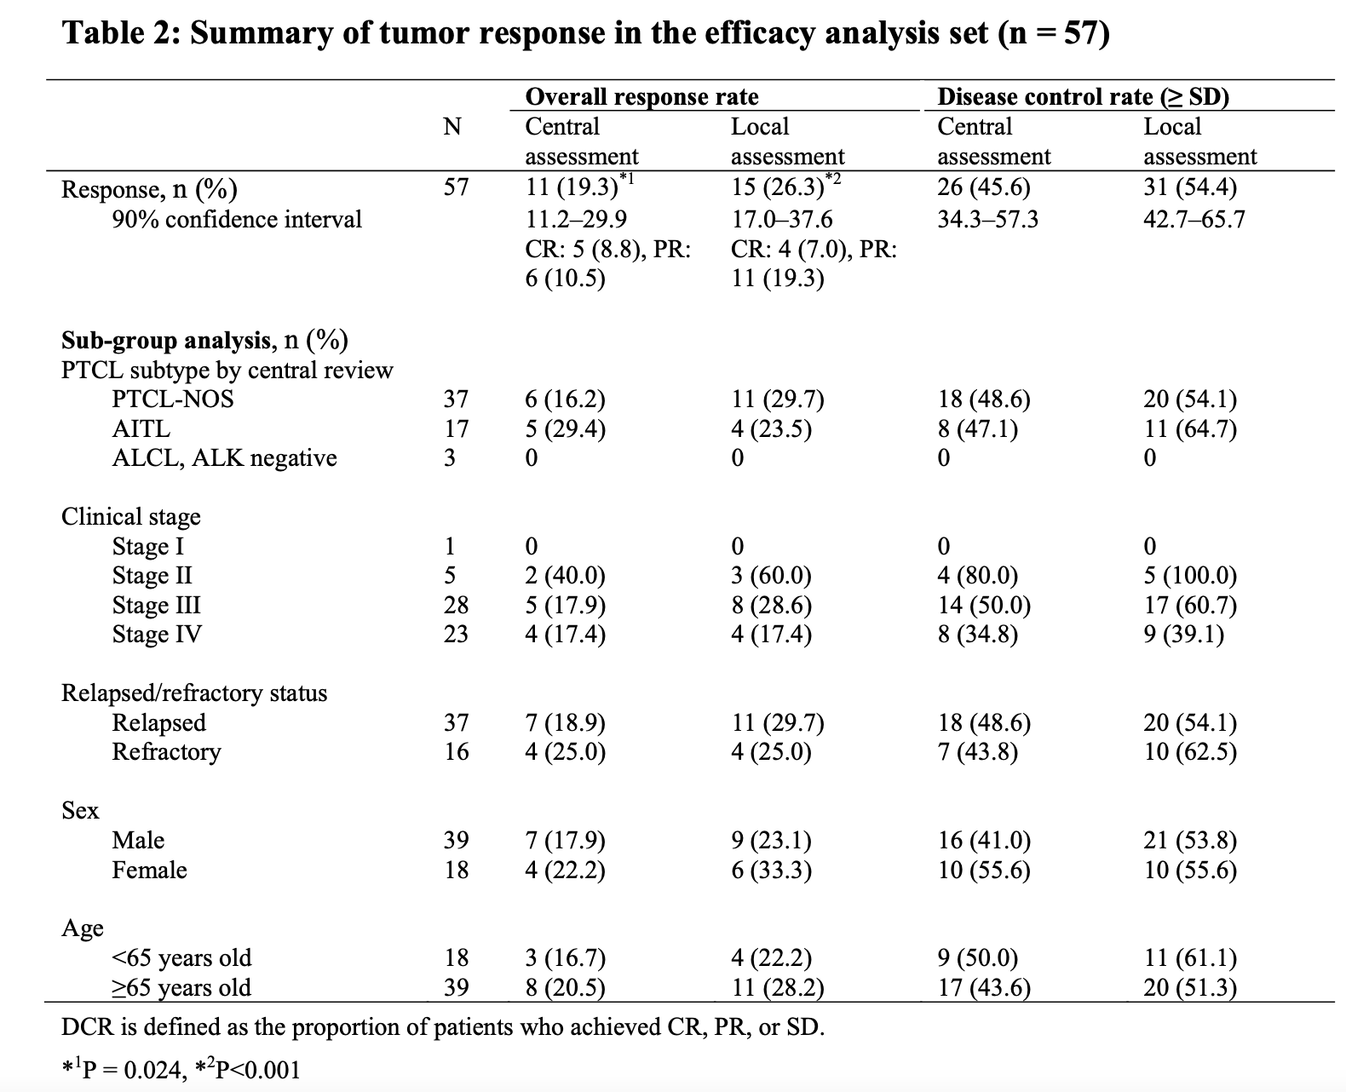
ClinicalTrials.gov: NCT02653976

Slide 22
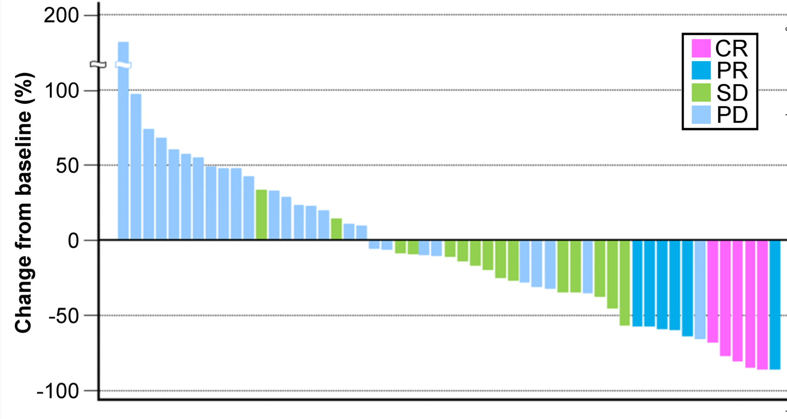
ClinicalTrials.gov: NCT02653976

Slide 23
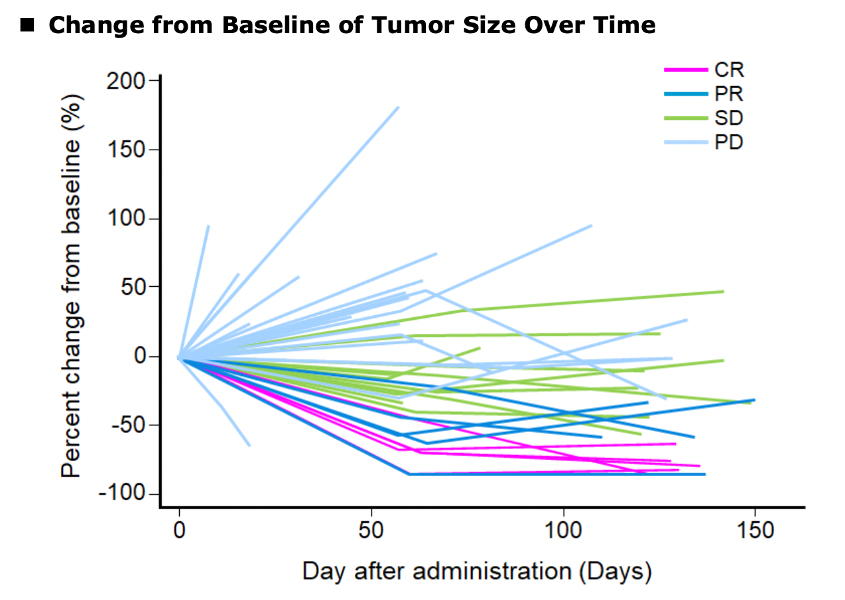
ClinicalTrials.gov: NCT02653976

Slide 24
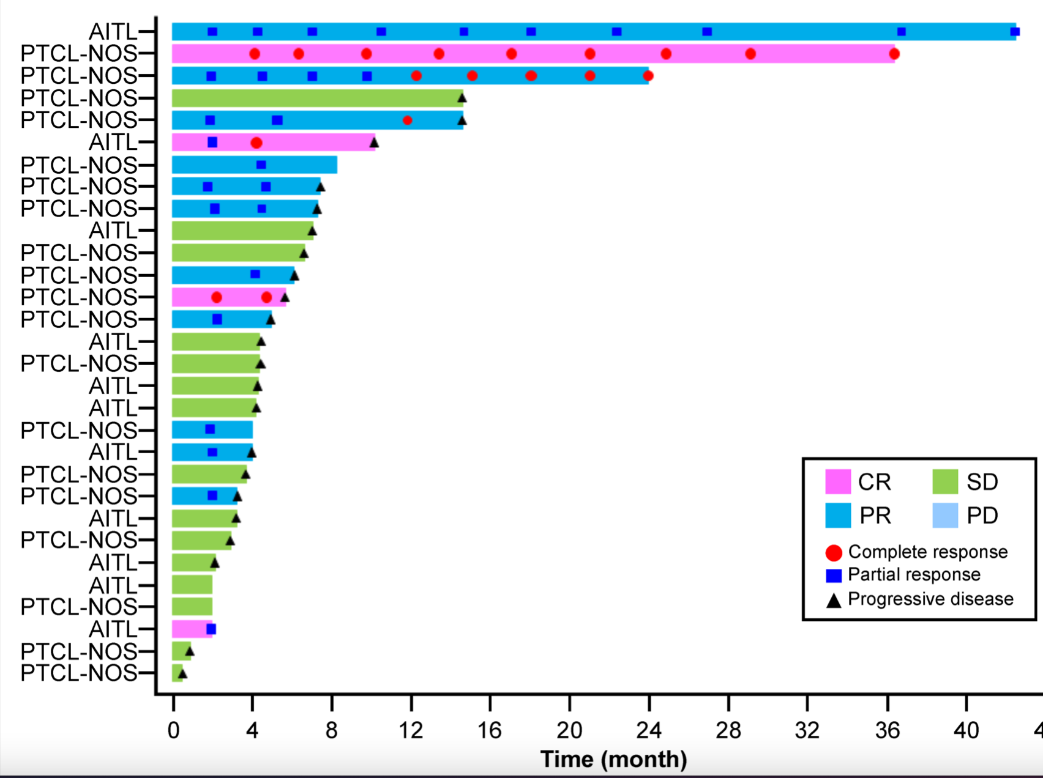
ClinicalTrials.gov: NCT02653976

Slide 25
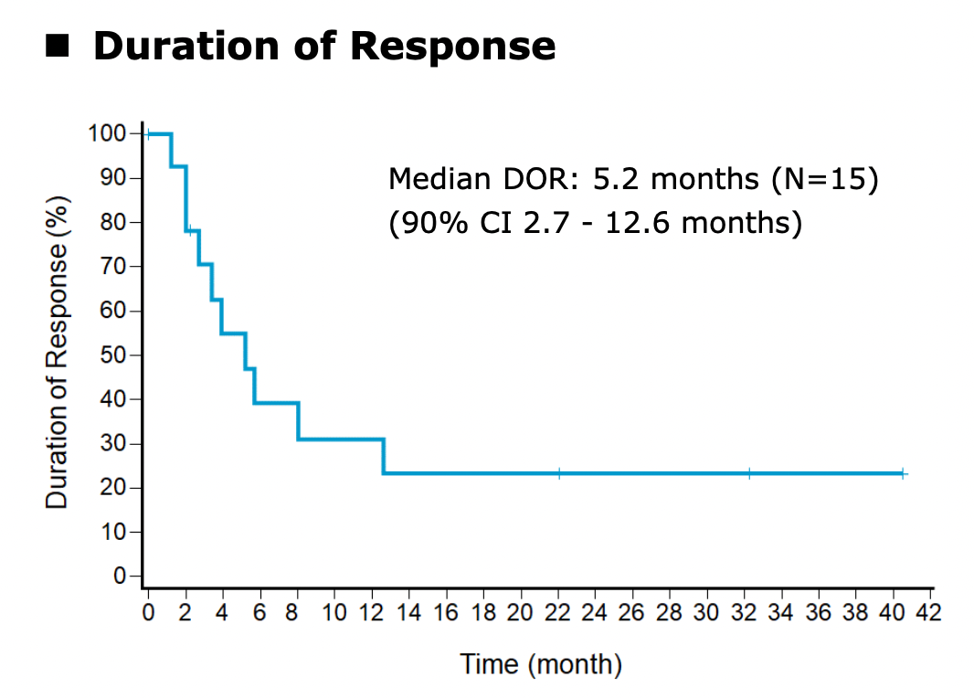
ClinicalTrials.gov: NCT02653976

Slide 26
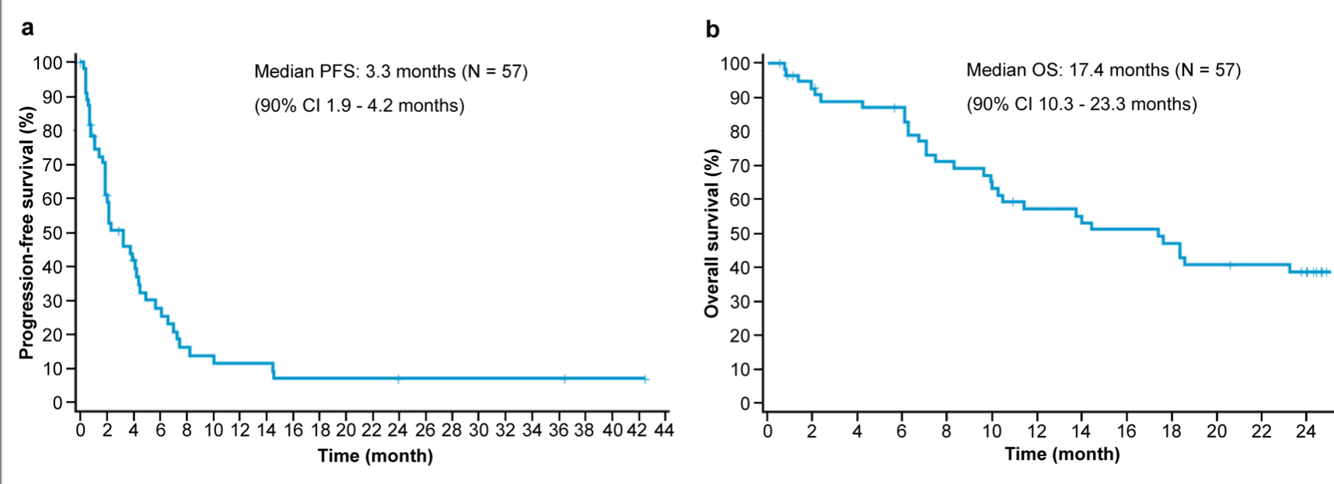
ClinicalTrials.gov: NCT02653976

Slide 27
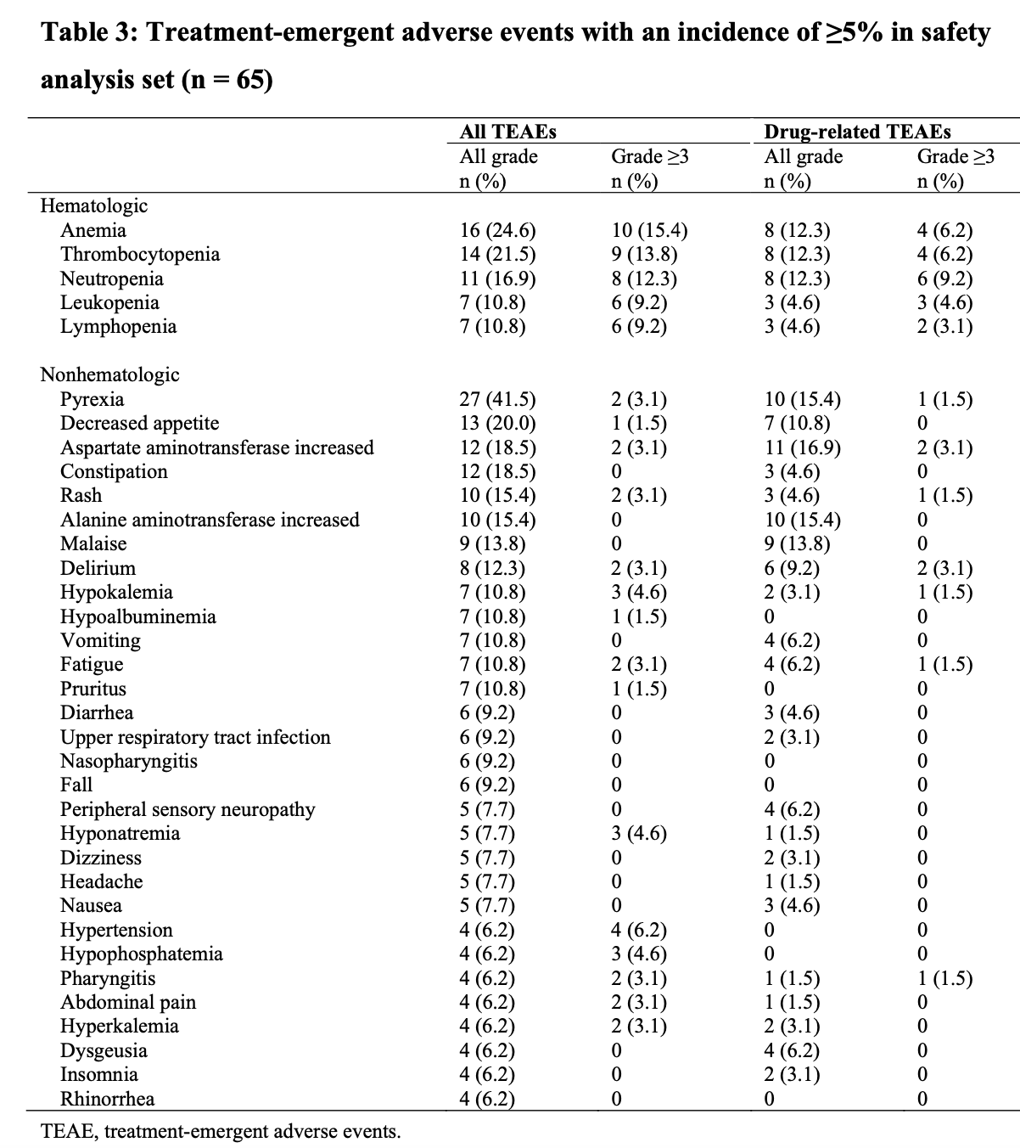
ClinicalTrials.gov: NCT02653976

Slide 28
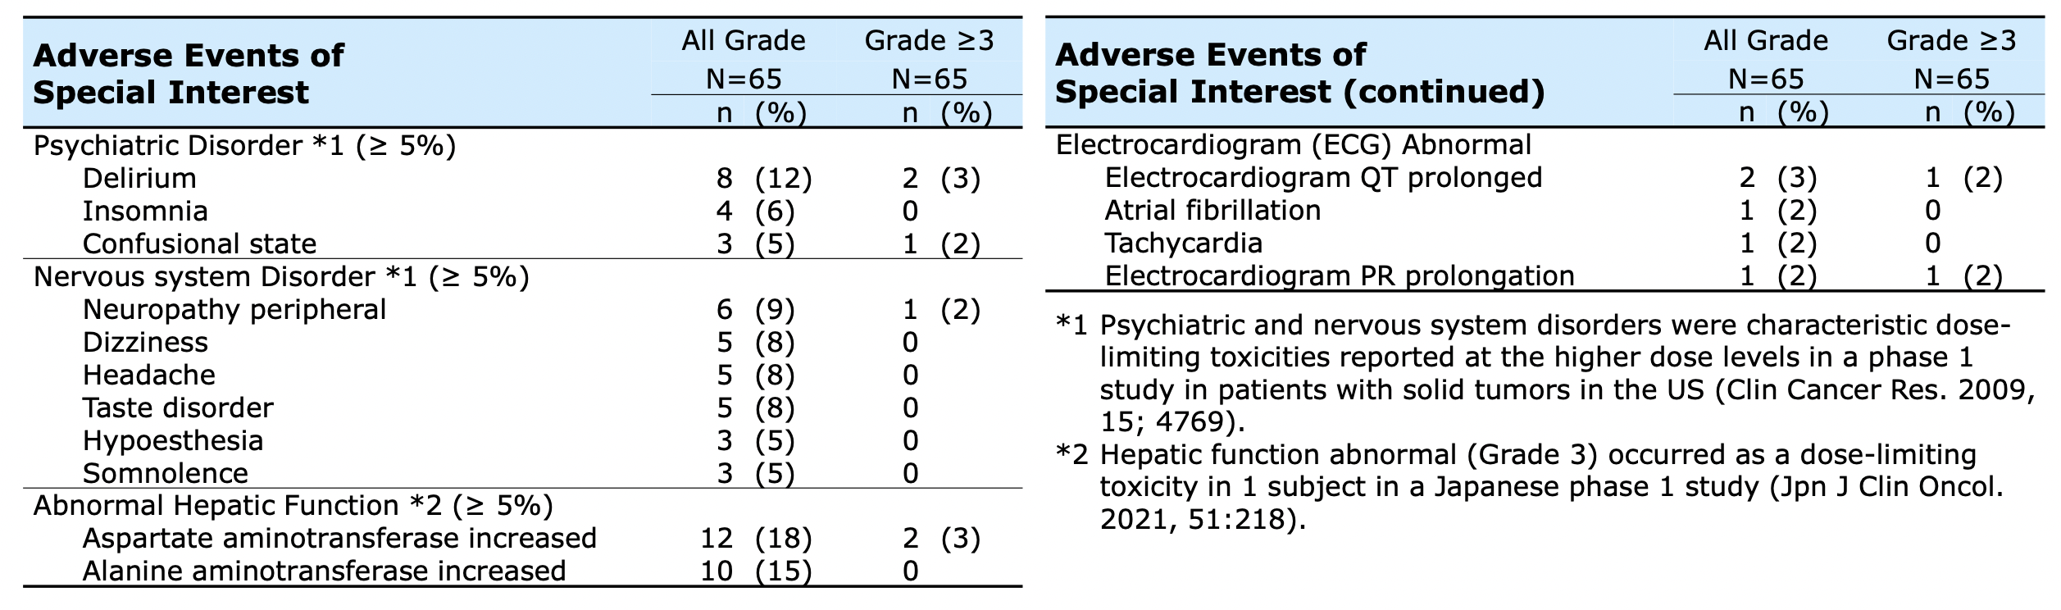
ClinicalTrials.gov: NCT02653976

Slide 29


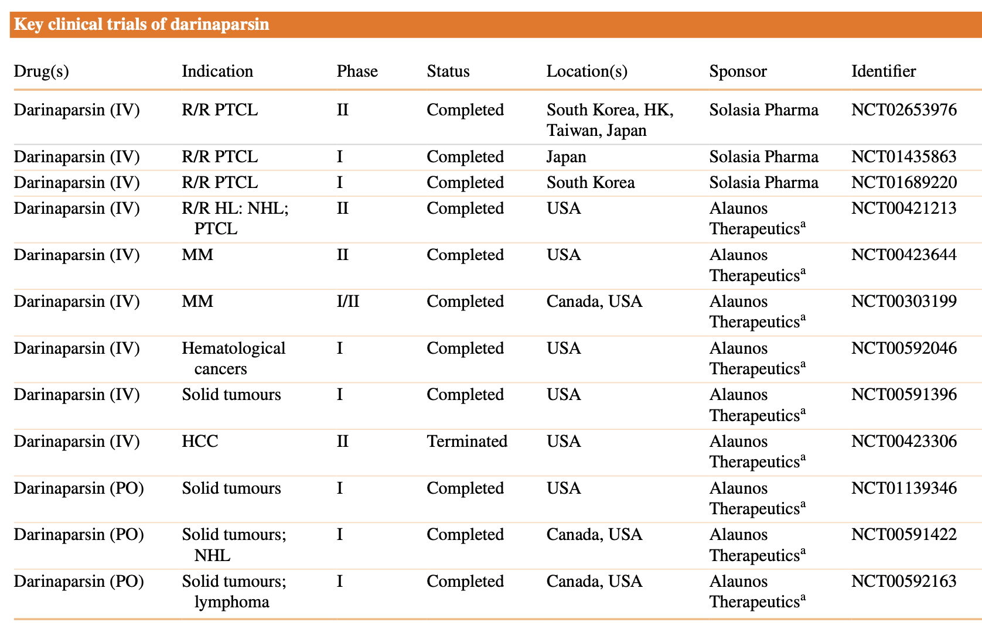

Slide 30
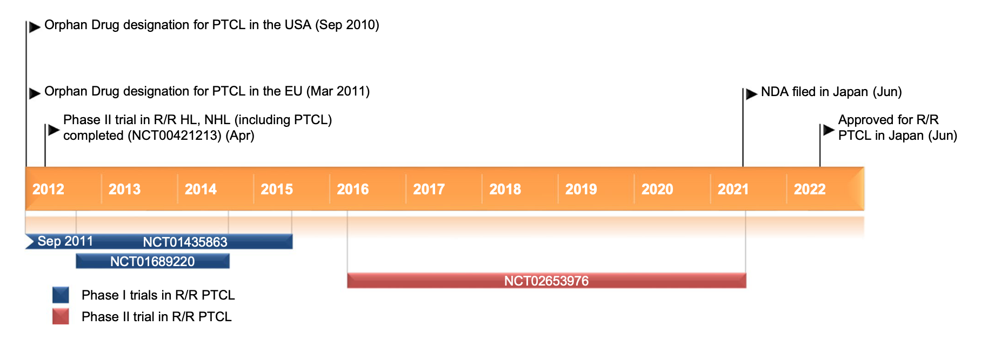

Slide 31


¡GRACIAS!

